Slide 1
Machine Learning From Scratch

Slide 2
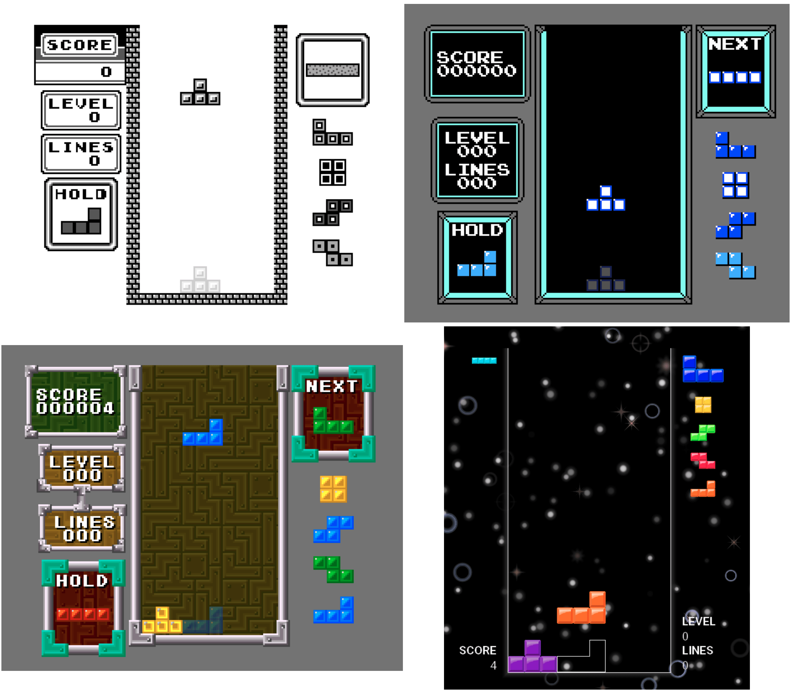
Tetris
Custom engine-less implementation
Rust
SDL2
Themes
Modern ruleset
https://ax-h.com/2024/09/15/rust-games

Slide 3
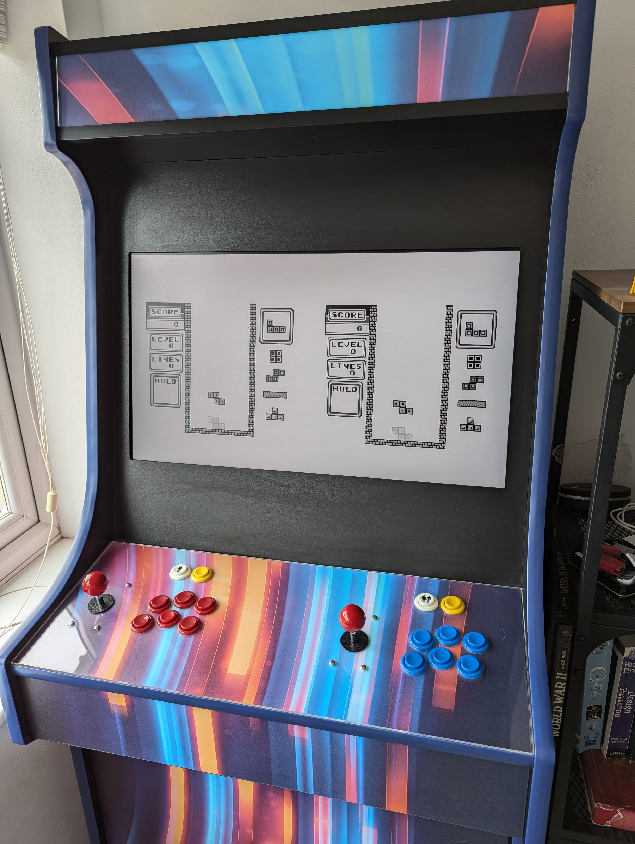
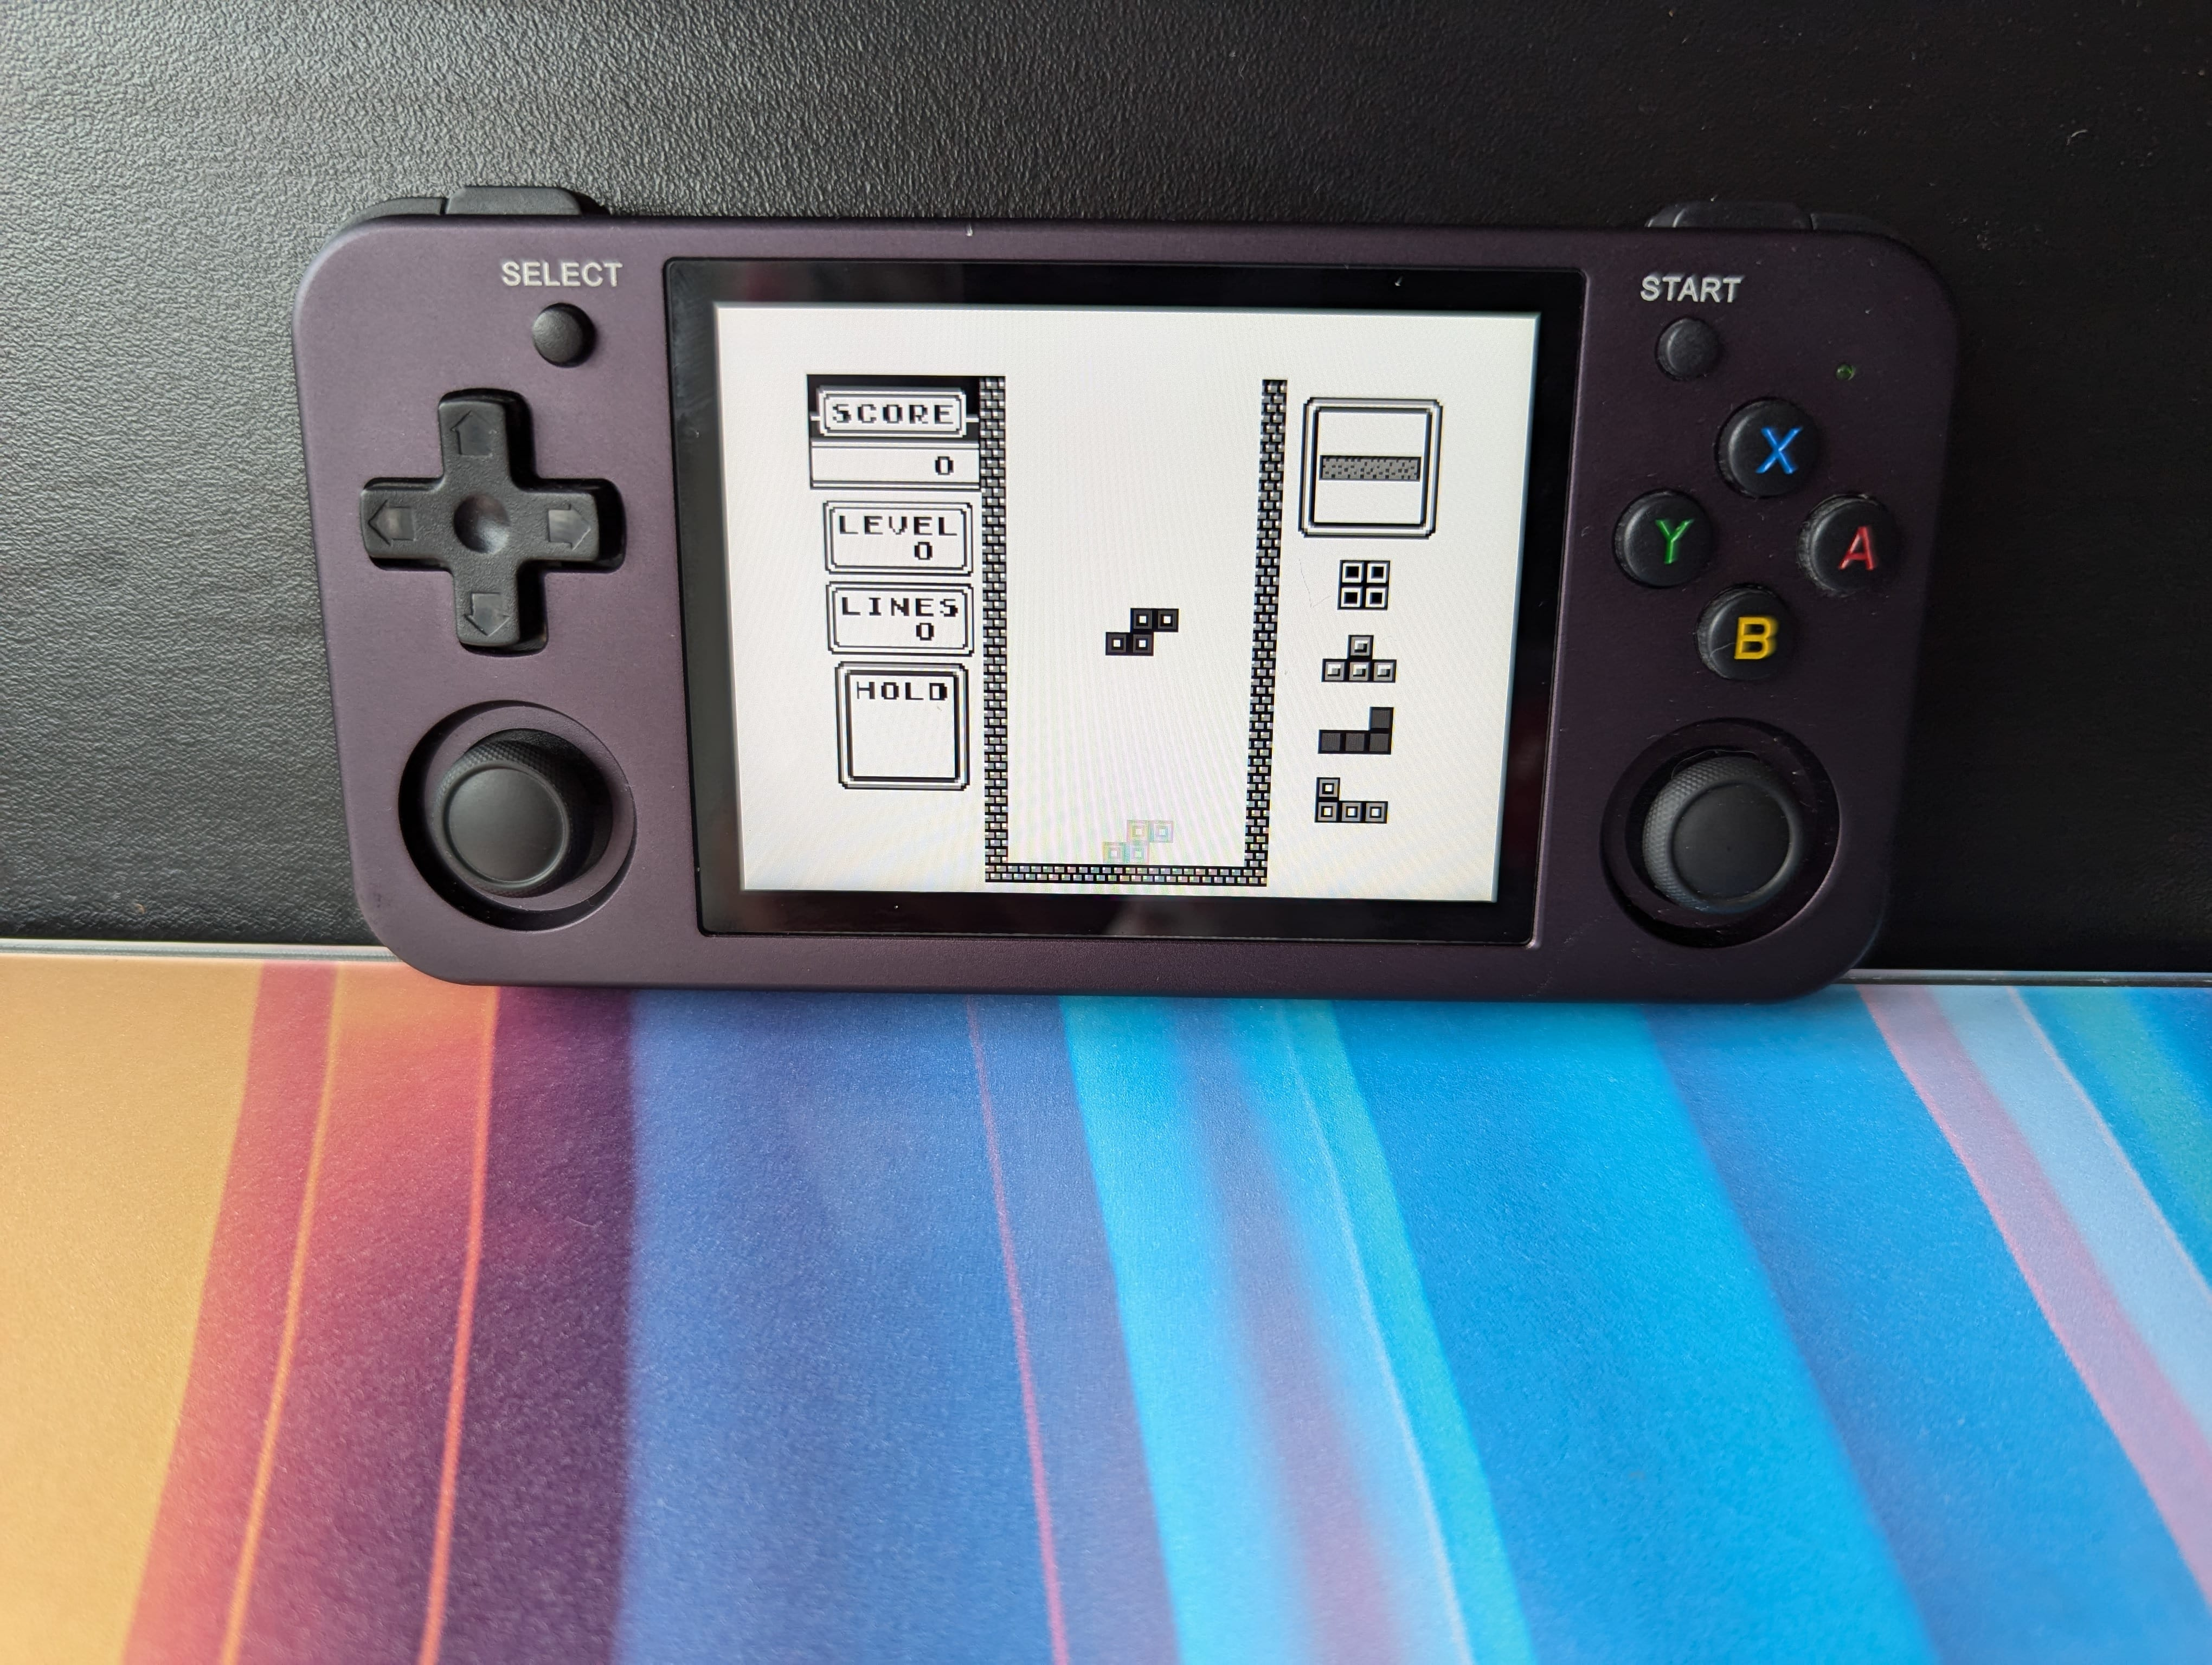
Cross Platform

Slide 4
Perfect Base for ML
Direct access to the game loop
fn game_loop() { let mut game = Game {}; let mut agent = AiAgent {}; loop { // let input = read_human_controls(); ← humans need not apply let input = agent.act(&game); // ← the agent is playing instead update_game_state(&mut game, input); draw_game(&game); } }
Rust has modern library & syntax but is fast AF

Slide 5
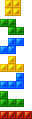
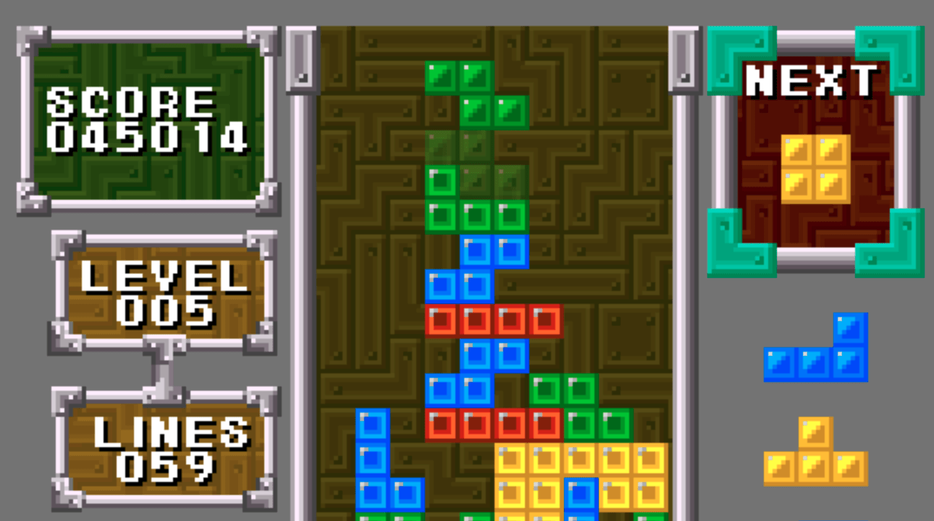
Terminology
Tetromino
O
Z
S
T
L
J
I
Peek
Stack

Slide 6
State
Model
Actions
But Tetris has
❌ Massive set of possible states 2²⁰⁰ = 1.6 * 10⁶⁰
❌ Human centric control scheme
❌ Spatial model that must be learned
✅ Set of features that we could extract
✅ Finite, fully searchable move-set between states

Slide 7
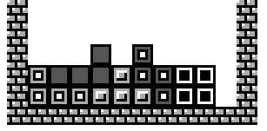
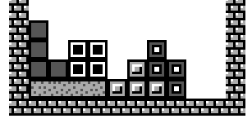
Features
Maximum Stack height e.g. 3 ❌ Tall ✅ Short
Roughness e.g. 2+1+2+1+1+1+2 = 10 ❌ Rough ✅ Smooth

Slide 8
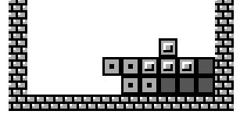
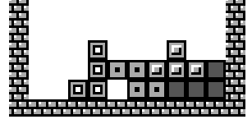
Features
Open holes One or more empty blocks with a stack block above but not on either side.
Can be filled by sliding a Tetromino.
Closed holes One or more empty blocks completely surrounded by stack or walls.
Can only be filled by removing stack blocks above.

Slide 9
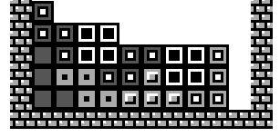
Features
Pillars
A gap 3 or more blocks tall.
Can only be filled with an I Tetromino.
Delta
All stack features are calculated as a delta
Also
Tetromino altitude
Line clear
Tetris clear

Slide 10
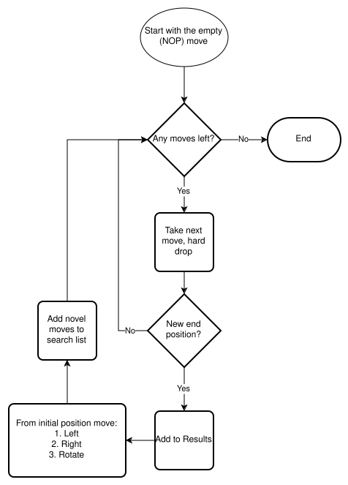
Move Search
Find all positions that the current Tetromino can be dropped into directly
From each dropped position check if sliding left, right or rotating results in a new position

Slide 11
Linear Regression
Classify all possible moves with a linear function:
Pick the move with the best Q
✅ Works surprisingly well
✅ Model parameters are legible
❌ Cannot model non-linear relationships between parameters

Slide 12
Supervised Learning
Linear regression is supervised ML
But Tetris is bad at supervised learning
Most solutions are BAD → exploration is hard
Labelling the data is difficult → Q is ordinal & not “really” quantitative → limited by human ability
Unsupervised “evolution” algorithms are better at Tetris

Slide 13
Genetic Algorithm
Generate random population of coefficients
Plug each into the agent→Play Tetris
Survival of the fittest: Rank by score
Top 1% → Immortal elite
Top 50% → Survive for reproduction
Bottom 50% → Die
Selection: Randomly pick parents from surviving population to reproduce with a chance scaled by their score
Randomly mutate the population
Go to 2

Slide 14
Linear Coefficients

Slide 15
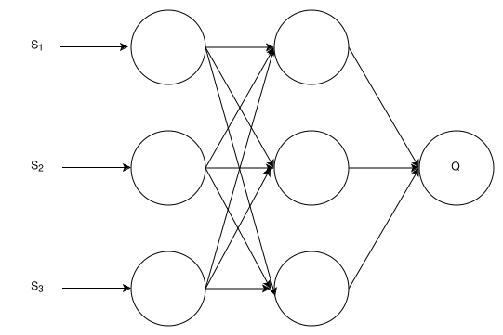
Neural Networks
MLP with features as input and a single output to estimate Q

Slide 16
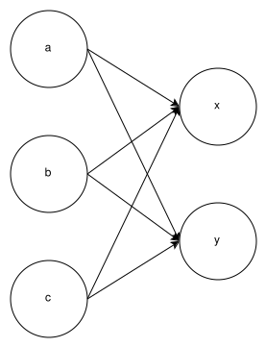
Weights
Strength of connection between neurons
Fully connected
Represented as a tensor
Bias
Added per neuron
Activation
Sigmoid, scale values 0..1

Slide 17
Training
Supervised → backpropagation
Would need to collect a load of labelled data
E.g. YouTube videos of professionals
Unsupervised → genetic algorithm
Each parameter is a genome
14 input parameters (features + delta features)
2 hidden layers
645 parameters in total

Slide 19

Demo

Slide 20
Other Stuff I Tried
Look ahead
Exponentially more moves to search
Can be too slow at runtime @60hz
Definitely too slow at training
Didn’t have a massive effect
Pruning
Models must be trained with it enabled

Slide 21
Next Steps
Reinforcement learning
E.g. Deep Q-Learning seeded with evolved MLP
Likely optimise rough evolved network
Probably won’t unlock more complicated strategies
Bigger networks
More parameters e.g. height of each column
Deeper
Longer training runs

